Slide 1

EWA Final Project
by
Grishav Bhardwaj -19csu118
Harshit Sharma -19csu411
Gopal -19csu115

Slide 2
Flow of the project
Home Page
Sign Up
Login
Owner Home Page
Add/Update/Delete/ Edit Profile Page
Logout
Customer Home Page
Search/Edit Profile Page
Logout
The Northcap University EWA
2

Slide 3
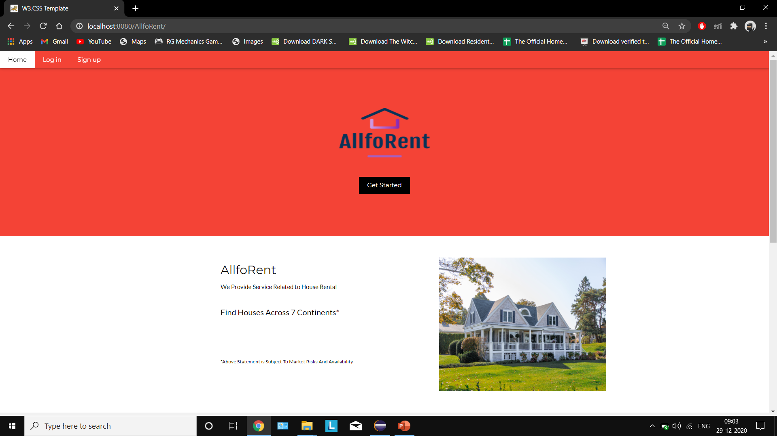
Home page index.jsp
This is the page our site starts at and it provides us with the options to Sign Up or Login and redirects to there respective pages.

Slide 4
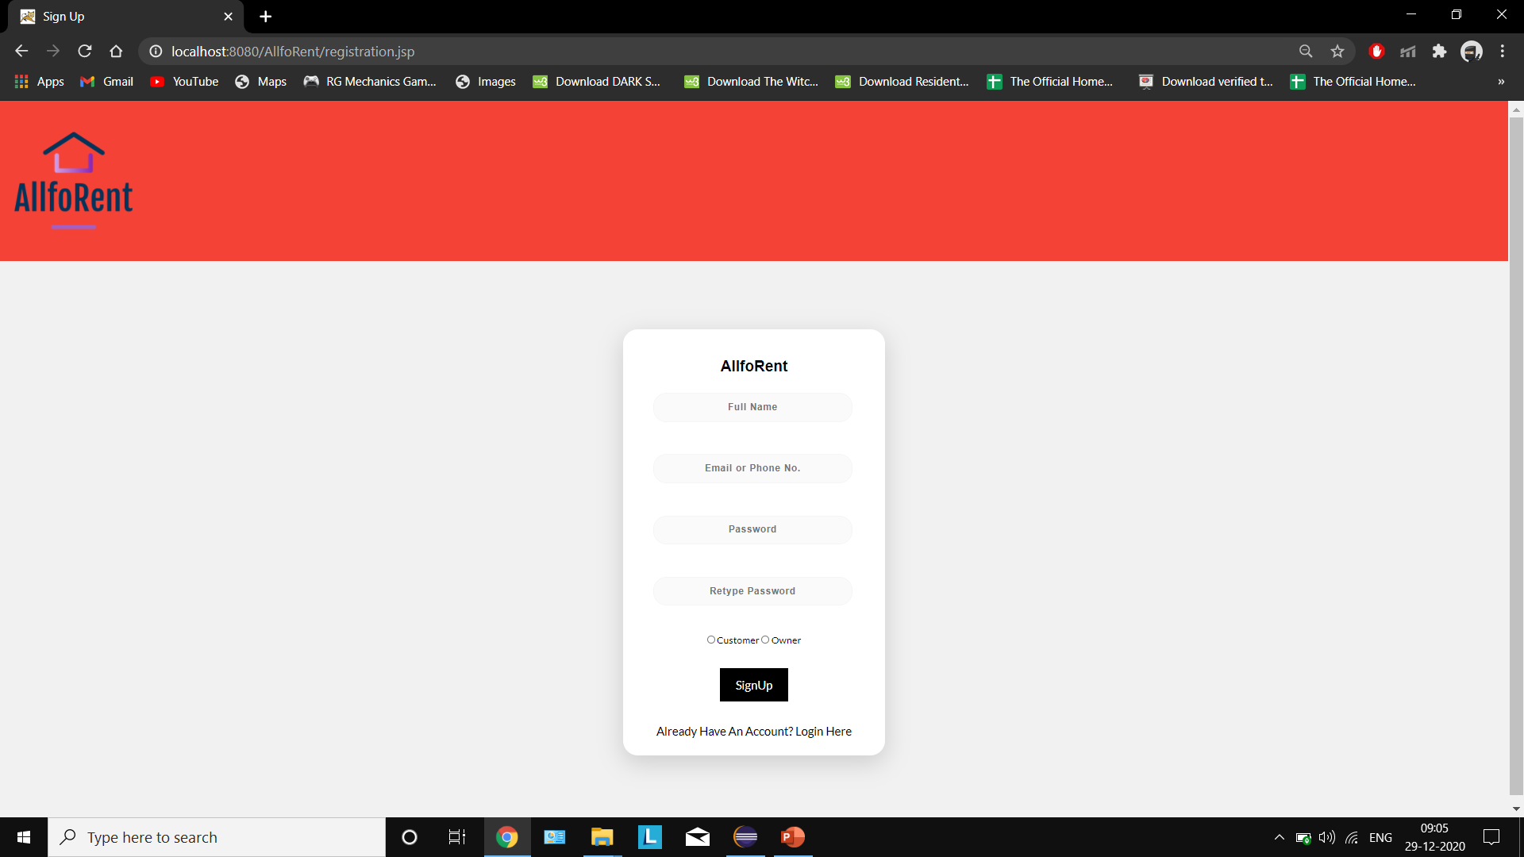
Sign up page registration.jsp
Here we register as a new customer or owner and get redirected to login page.
Sign Up requests are handled by the servlet RegistrationHandler.java

Slide 5
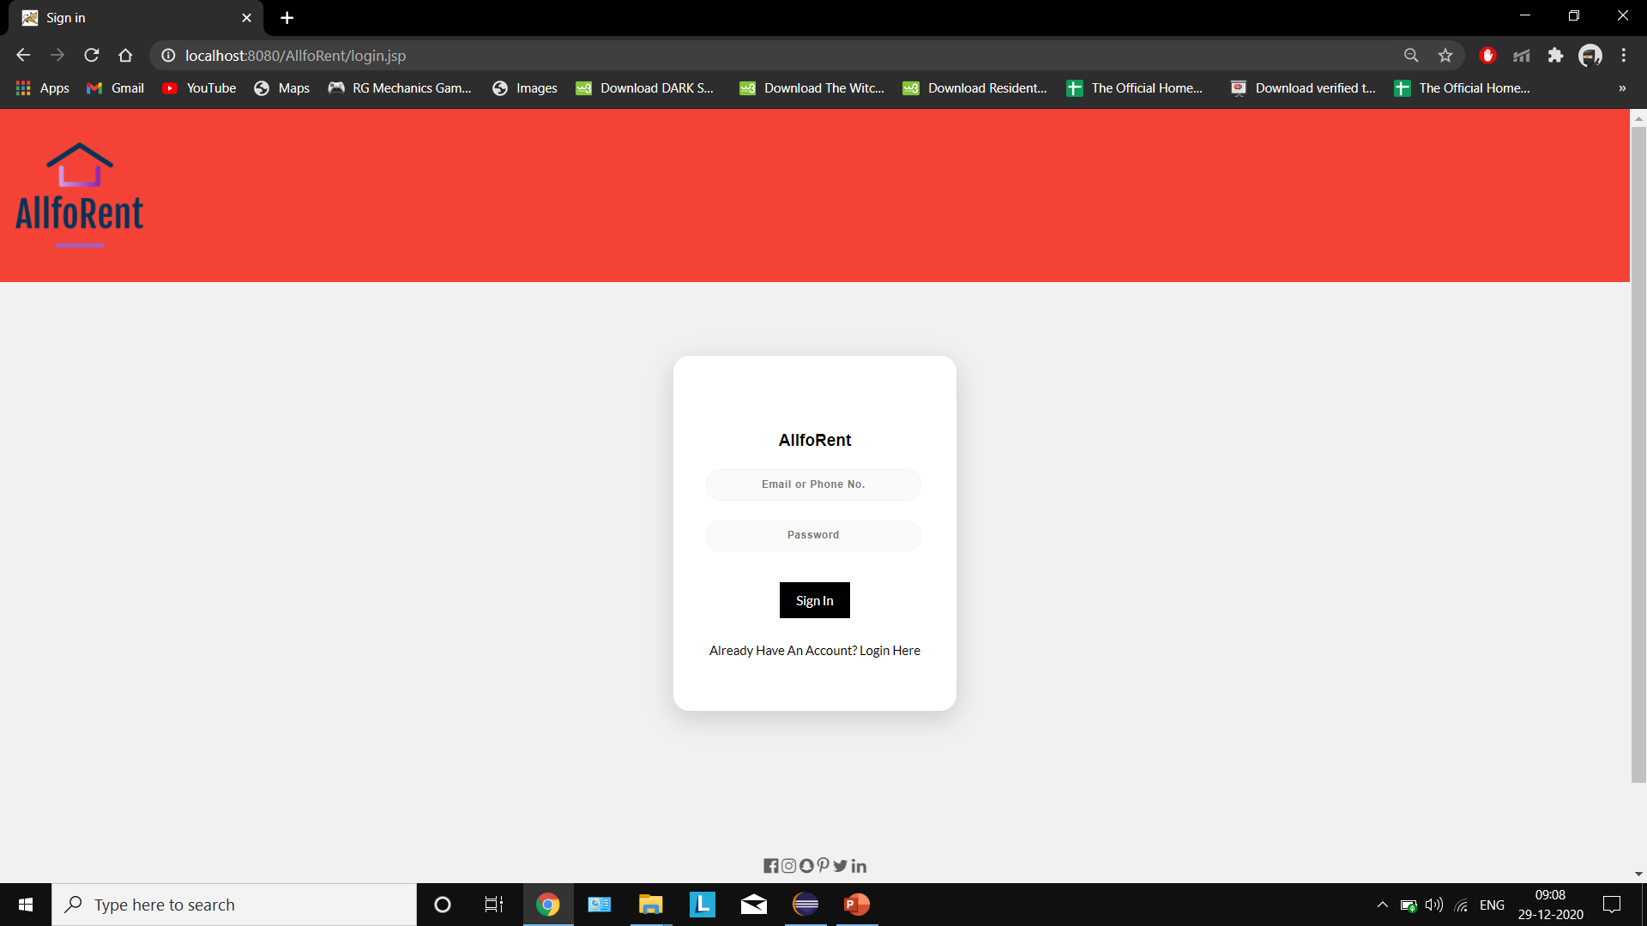
Login page login.jsp
Here we login as customer or owner and get redirected to respective customer or owner home page.
Login requests are handled by the servlet Login.java
On successful login a new session is created.

Slide 6
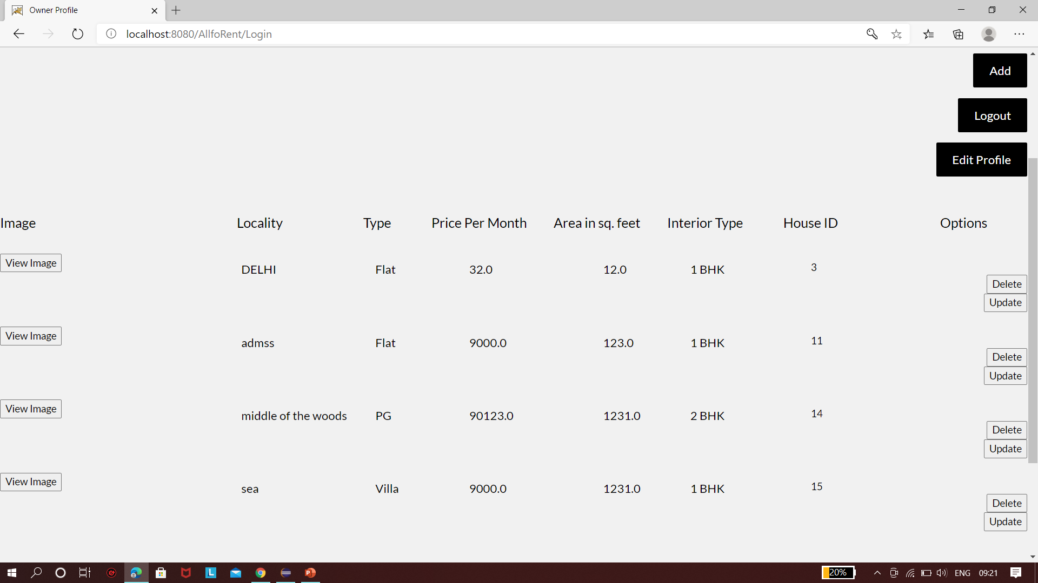
owner home page owner.jsp
Here all the houses that are uploaded by a particular owner are displayed and the options to view house image, edit profile, add new house, update existing houses, delete existing houses and logout are also provided.
Logout invalidates the session and redirects us to the home page.
The processing of delete request is done by the servlet DeleteProcess.java
The image of all the houses is displayed using the servlet GetImage.java

Slide 7
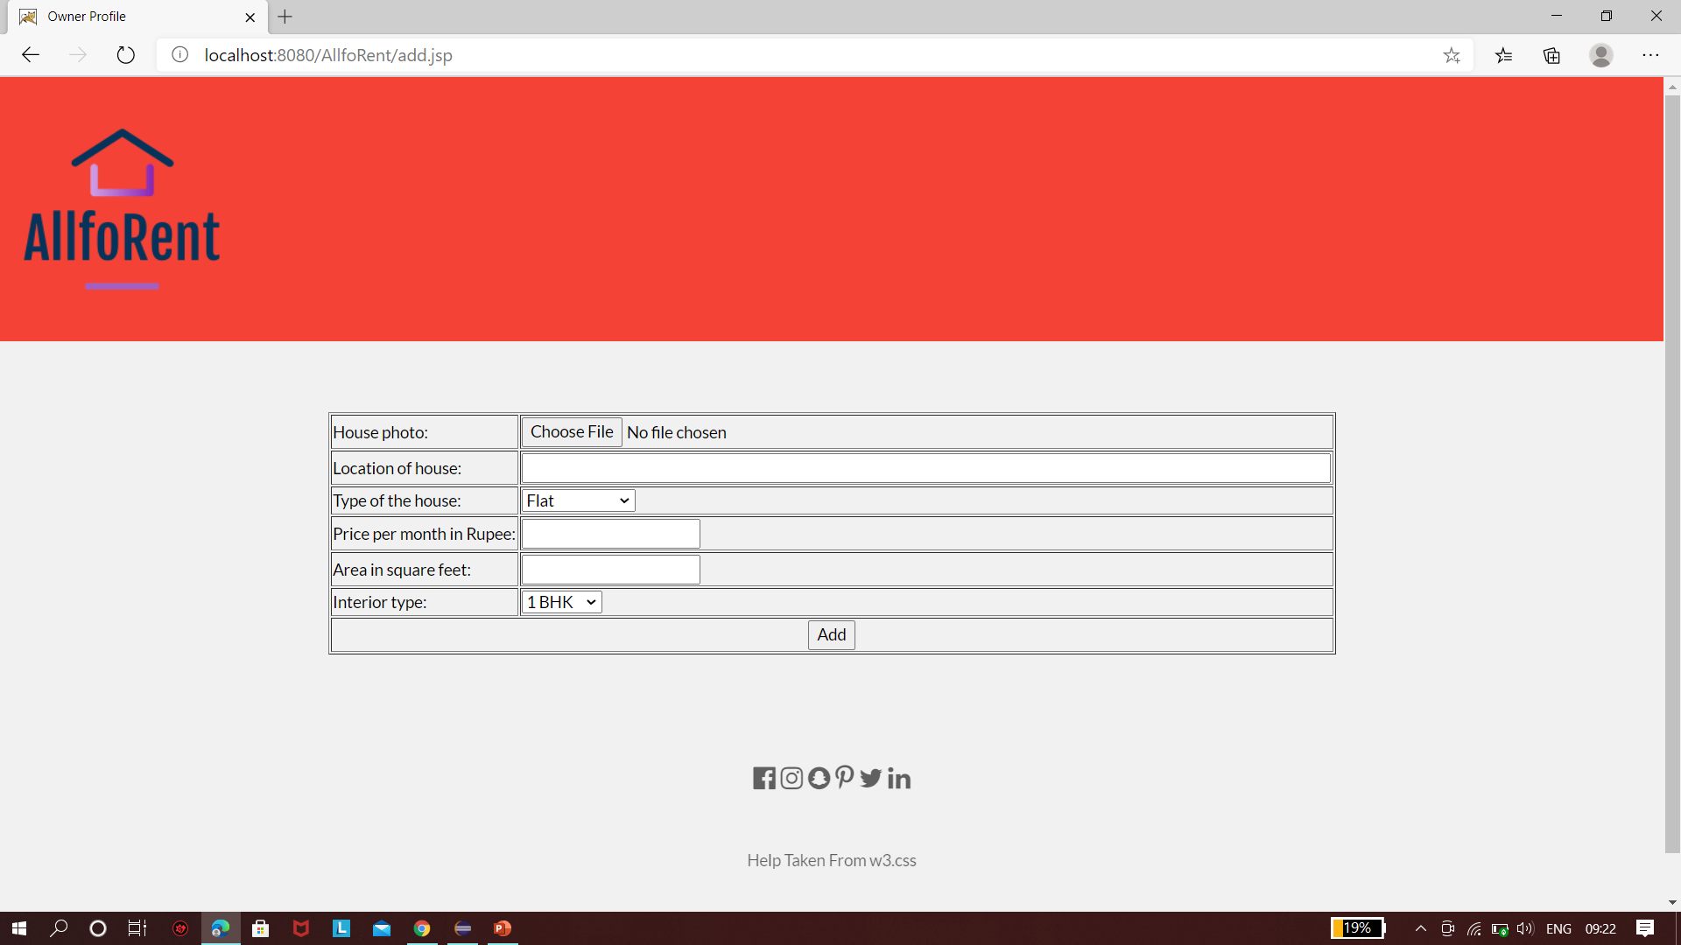
owner Add page add.jsp
Here we are presented with the options to upload image for the new house, write locality, choose type of house, enter the rent per month, area of the house and interior type of house.
The processing of add request is done by the servlet AddProcess.java

Slide 8
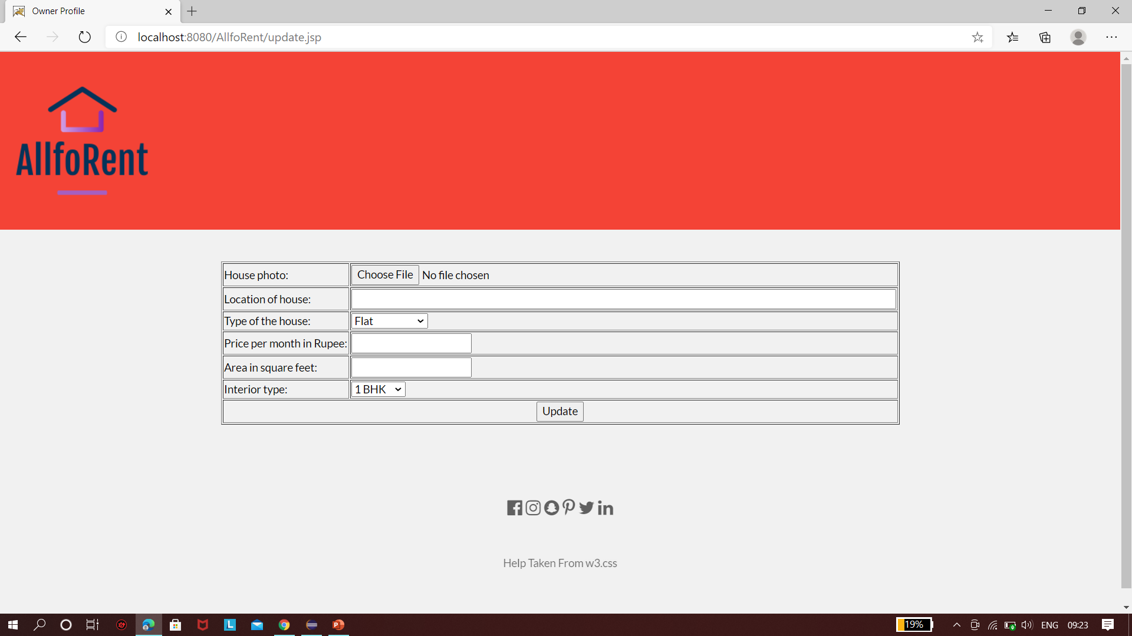
owner Update page update.jsp
Here we are presented with the options to change image for the house, change locality, change type of the house, change the rent per month, area of the house and interior type of house.
Any field can be left empty if it is not the one in need for a change.
The processing of update request is done by the servlet UpdateProcess.java

Slide 9
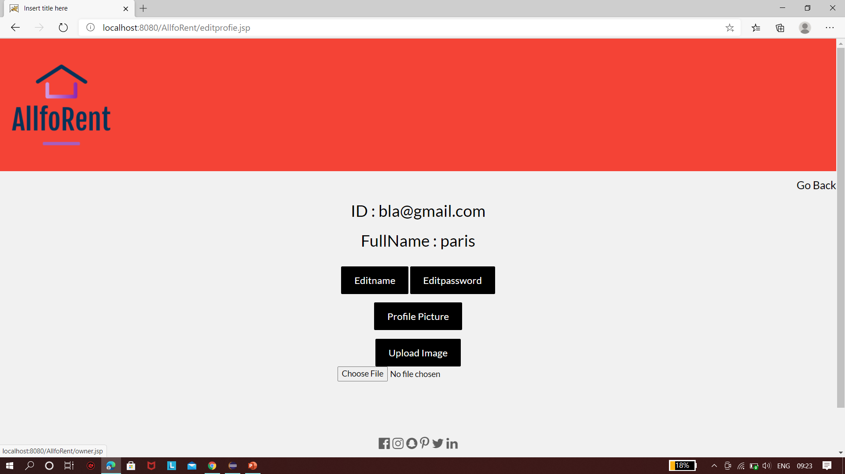
owner Edit profile editprofie.jsp
Here we are presented with the options to edit profile picture, edit name,edit password, view profile picture.
Edit profile picture request is processed at the servlet AddImage.java
View profile picture is processed by the servlet UploadImage.java
Edit name is processed at the Servlet MainEdit.java
Edit password is processed at the Servlet EditProfile.java

Slide 10
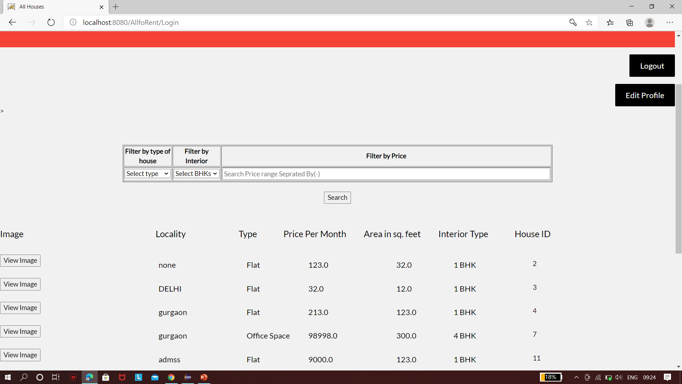
Customer Home page customer.jsp
Here all the houses that are available are displayed and the options to filter house according to type of houses, interior type, price range and logout option are also provided.
Logout invalidates the session and redirects us to home page.
The processing of filter requests is done by SearchResult.jsp
The image of all the houses is displayed using the servlet GetImage.java

Slide 11
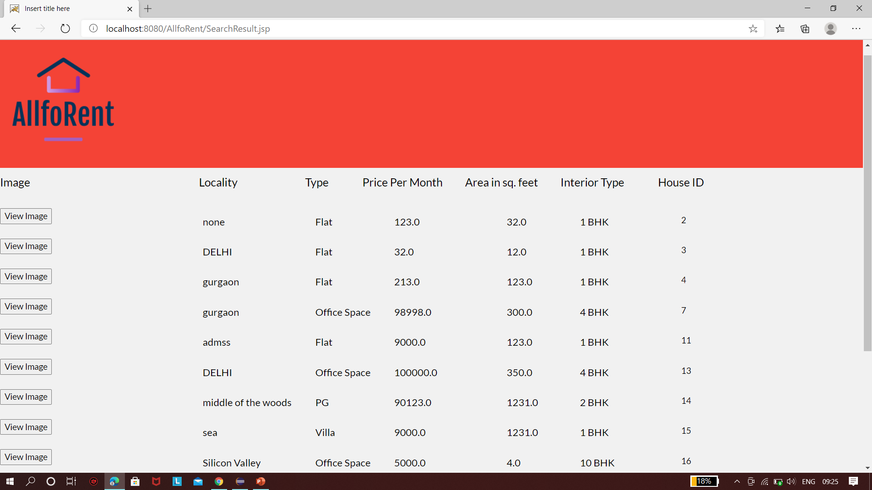
Customer Search result page searchresult.jsp
Here all the houses that fit the criterion of filters are displayed.

Slide 12
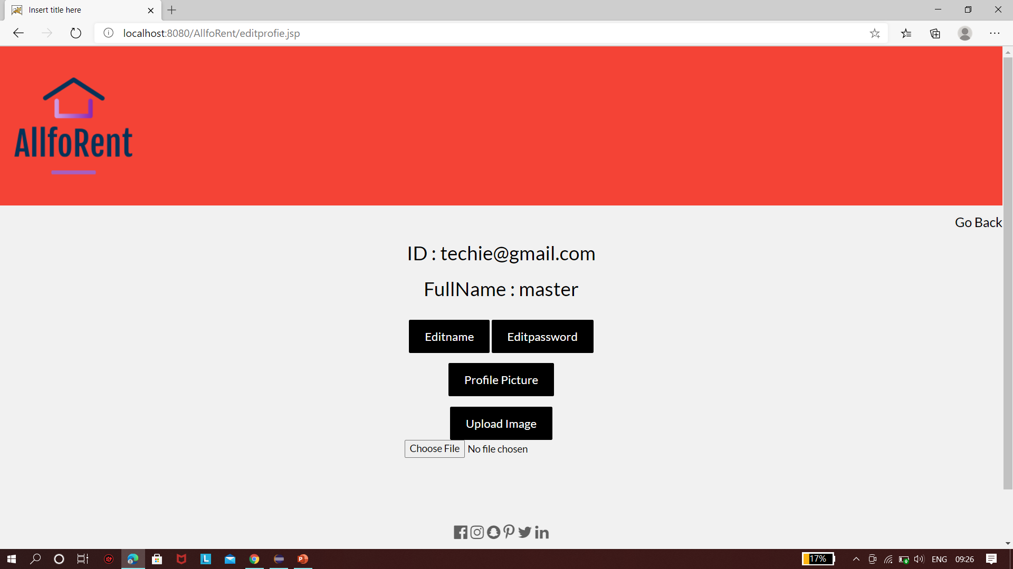
Customer Edit profile editprofie.jsp
Here we are presented with the options to edit profile picture, edit name,edit password, view profile picture.
Edit profile picture request is processed at the servlet AddImage.java
View profile picture is processed by the servlet UploadImage.java
Edit name is processed at the Servlet MainEdit.java
Edit password is processed at the Servlet EditProfile.java

Slide 13
Thank You

